Slide 1


DEPARTMENT OF ELECTRONICS AND COMMUNICATION ENGINEERING
18ECP103L-MINOR PROJECT-1
FINAL REVIEW
DESIGN AND DEVELOPMENT OF MICROSTRIP PATCH ANTENNA WITH NANOFERRITE MATERIAL
BATCH NO: 34
PRESENTED BY:
MUTHULAKSHMI M
MONISHA A
NANDHINI G
NAVANEETHA S
GUIDE BY :
Dr. R. RAJESH KANNA
AP, ECE
Date :24.11.2022

Slide 2
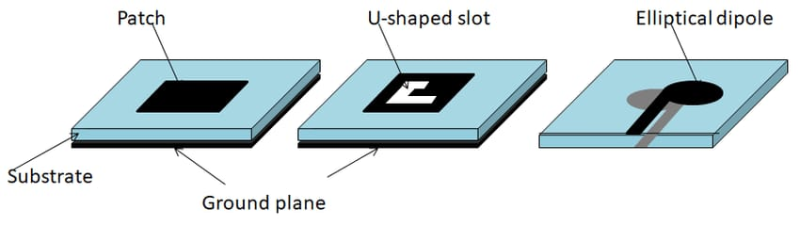
CONTENTS
INTRODUCTION
LITERATURE SURVEY
OBJECTIVE
EXISTING METHODS
NEW METHODS
TOOLS USED
REFERENCES

Slide 3
INTRODUCTION
Antennas are key components of any wireless system.
An antenna is a device that transmits and receives electromagnetic waves.
Nanoscale ferrites exhibit superior magnetic properties when compared to the bulk and pure metal.
Nanoferrite material properties like dielectric constant and loss will be used for substrate material for antenna design.

Slide 4
LITERATURE SURVEY
A microstrip rectangular patch antenna fabricated on LiTiMg ferrite substrate is presented which has also been compared with same structure of antenna on dielectric.
For this work we have synthesized the polycrystalline LiTiMg ferrite by the solid state reaction technique (SSRT) and characterized their electric and magnetic properties.
The proposed materials offers tunable dielectric and magnetic properties with soft magnetic behaviors and easy to use where arbitrarily electromagnetic values are required.
Moreover, these materials also can be played significant role in flexible microwave field as low cost flexible substrates for compact flexible antennas, metamaterials, absorbers, and sensors applications etc.

Slide 5
The lower dielectric losses and magnetic losses for all compositions of ferrite material were useful for miniaturization of antenna. The patches of silver material were printed on fabricated substrates by using screen printing technique.
The objective is to achieve matching impedances, low magnetic and dielectric losses (tan δμ and tan δε , respectively), and a relatively large miniaturization factor to reduce antenna size.

Slide 6
OBJECTIVE
In this present investigation nanoferrite material are synthesized by sono chemical method.
The prepared nano material are characterised by different characteristic method.
The observed parameter of the nanoferrite material are use as substrate to the microstrip patch Antenna. The microstrip patch antenna is simulated by HFSS simulator.

Slide 7
EXISTING METHODS
Sol-Gel method
Multiple-Input Multiple Output
Lens Antenna
Parabolic reflector Antenna

Slide 8
NEW METHODS
Sonochemical method
Nanoferrite based substrate for MPA

Slide 9
TOOLS REQUIRED
HFSS [High Frequency Simulation Software]
Sonochemical
XRD[X-Ray Diffraction]
FTIR[Fourier Transform Infrared]
SEM[Scanning Electron Microscope]
Dielectric study
VSM[Vibrating Sample Magnetometer]

Slide 10
REFERENCES
Naveen Kumar Saxena Nitendar Kumar P.K.S.Pourush, Radiation Characteristics of Microstrip RectangularPatch Antenna Fabricated on LiTiMg Ferrite Substrate, International Journal of Electronics and Communications, 96 (2018), 246-251.
Vinaykumar, J. Bera, Characterizations of low-temperature sintered BaCo1.3Ti1.3Fe9.4O19 M-type ferrite for high-frequency antenna application,Journal of Magnetism and Magnetic Material, 451,2018,614-619.

Slide 11
M.M. Syazwan ,A.N. Hapishah , M.N. Hamidon , I. Ismail , I.H. Hasan,Design and development of Ni0.75Zn0.25Fe2O4/MWCNT microstrip patch antenna (MPA) for ISM band spectrum applications,The Journal of Electronic Polymers and Electronic Molecular Metals ,291, 2022.
Md Atiqur Rahman, Mohammad Tariqul Islam ,Mandeep Jit Singh, Ismail Hossain , Hatem Rmili,Md Samsuzzaman,Magnetic, dielectric and structural properties of CoxZn(0.90-x)Al0.10Fe2O4 synthesized by solegel method with application as flexible microwave substrates for microstrip patch antenna,Journel of Materials Research and Technology, 20, 2022.

Slide 12
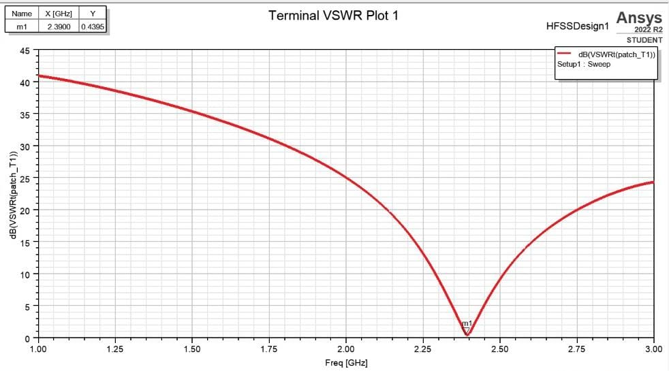

Slide 13
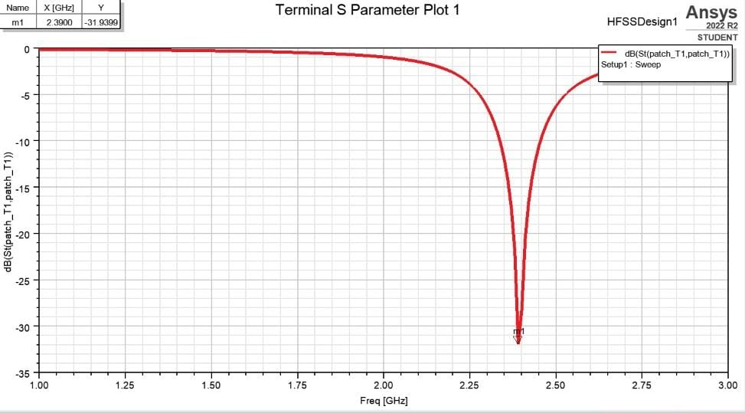

Slide 14
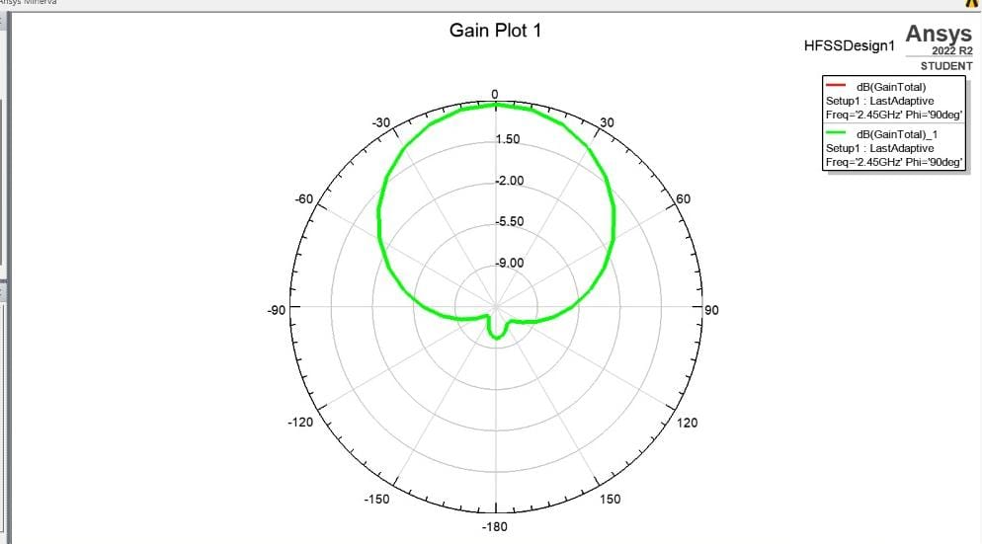

Slide 15
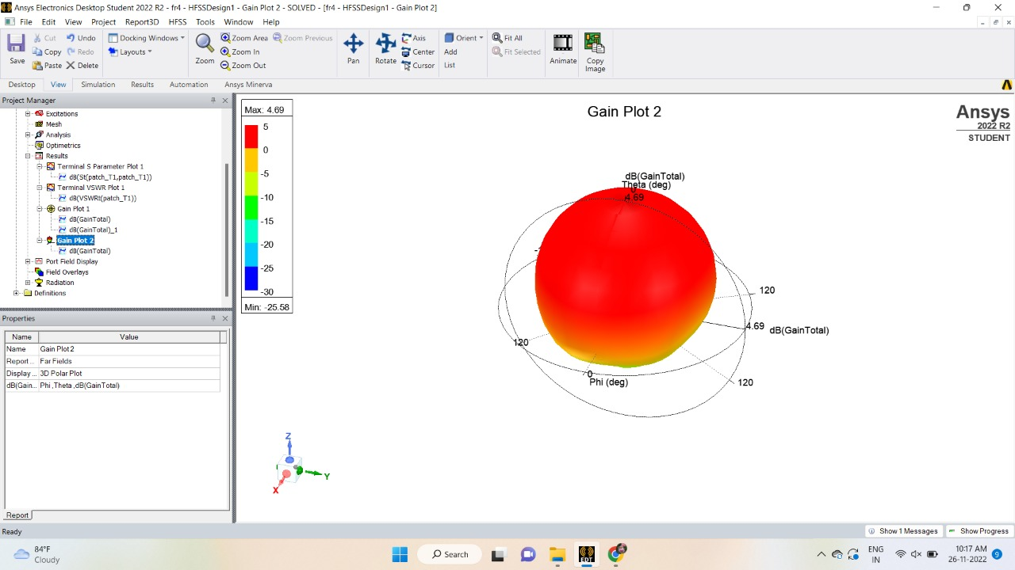

Slide 16


